Slide 1

WEC Systems
GPU Programming on Android
By Nimesh

Slide 2
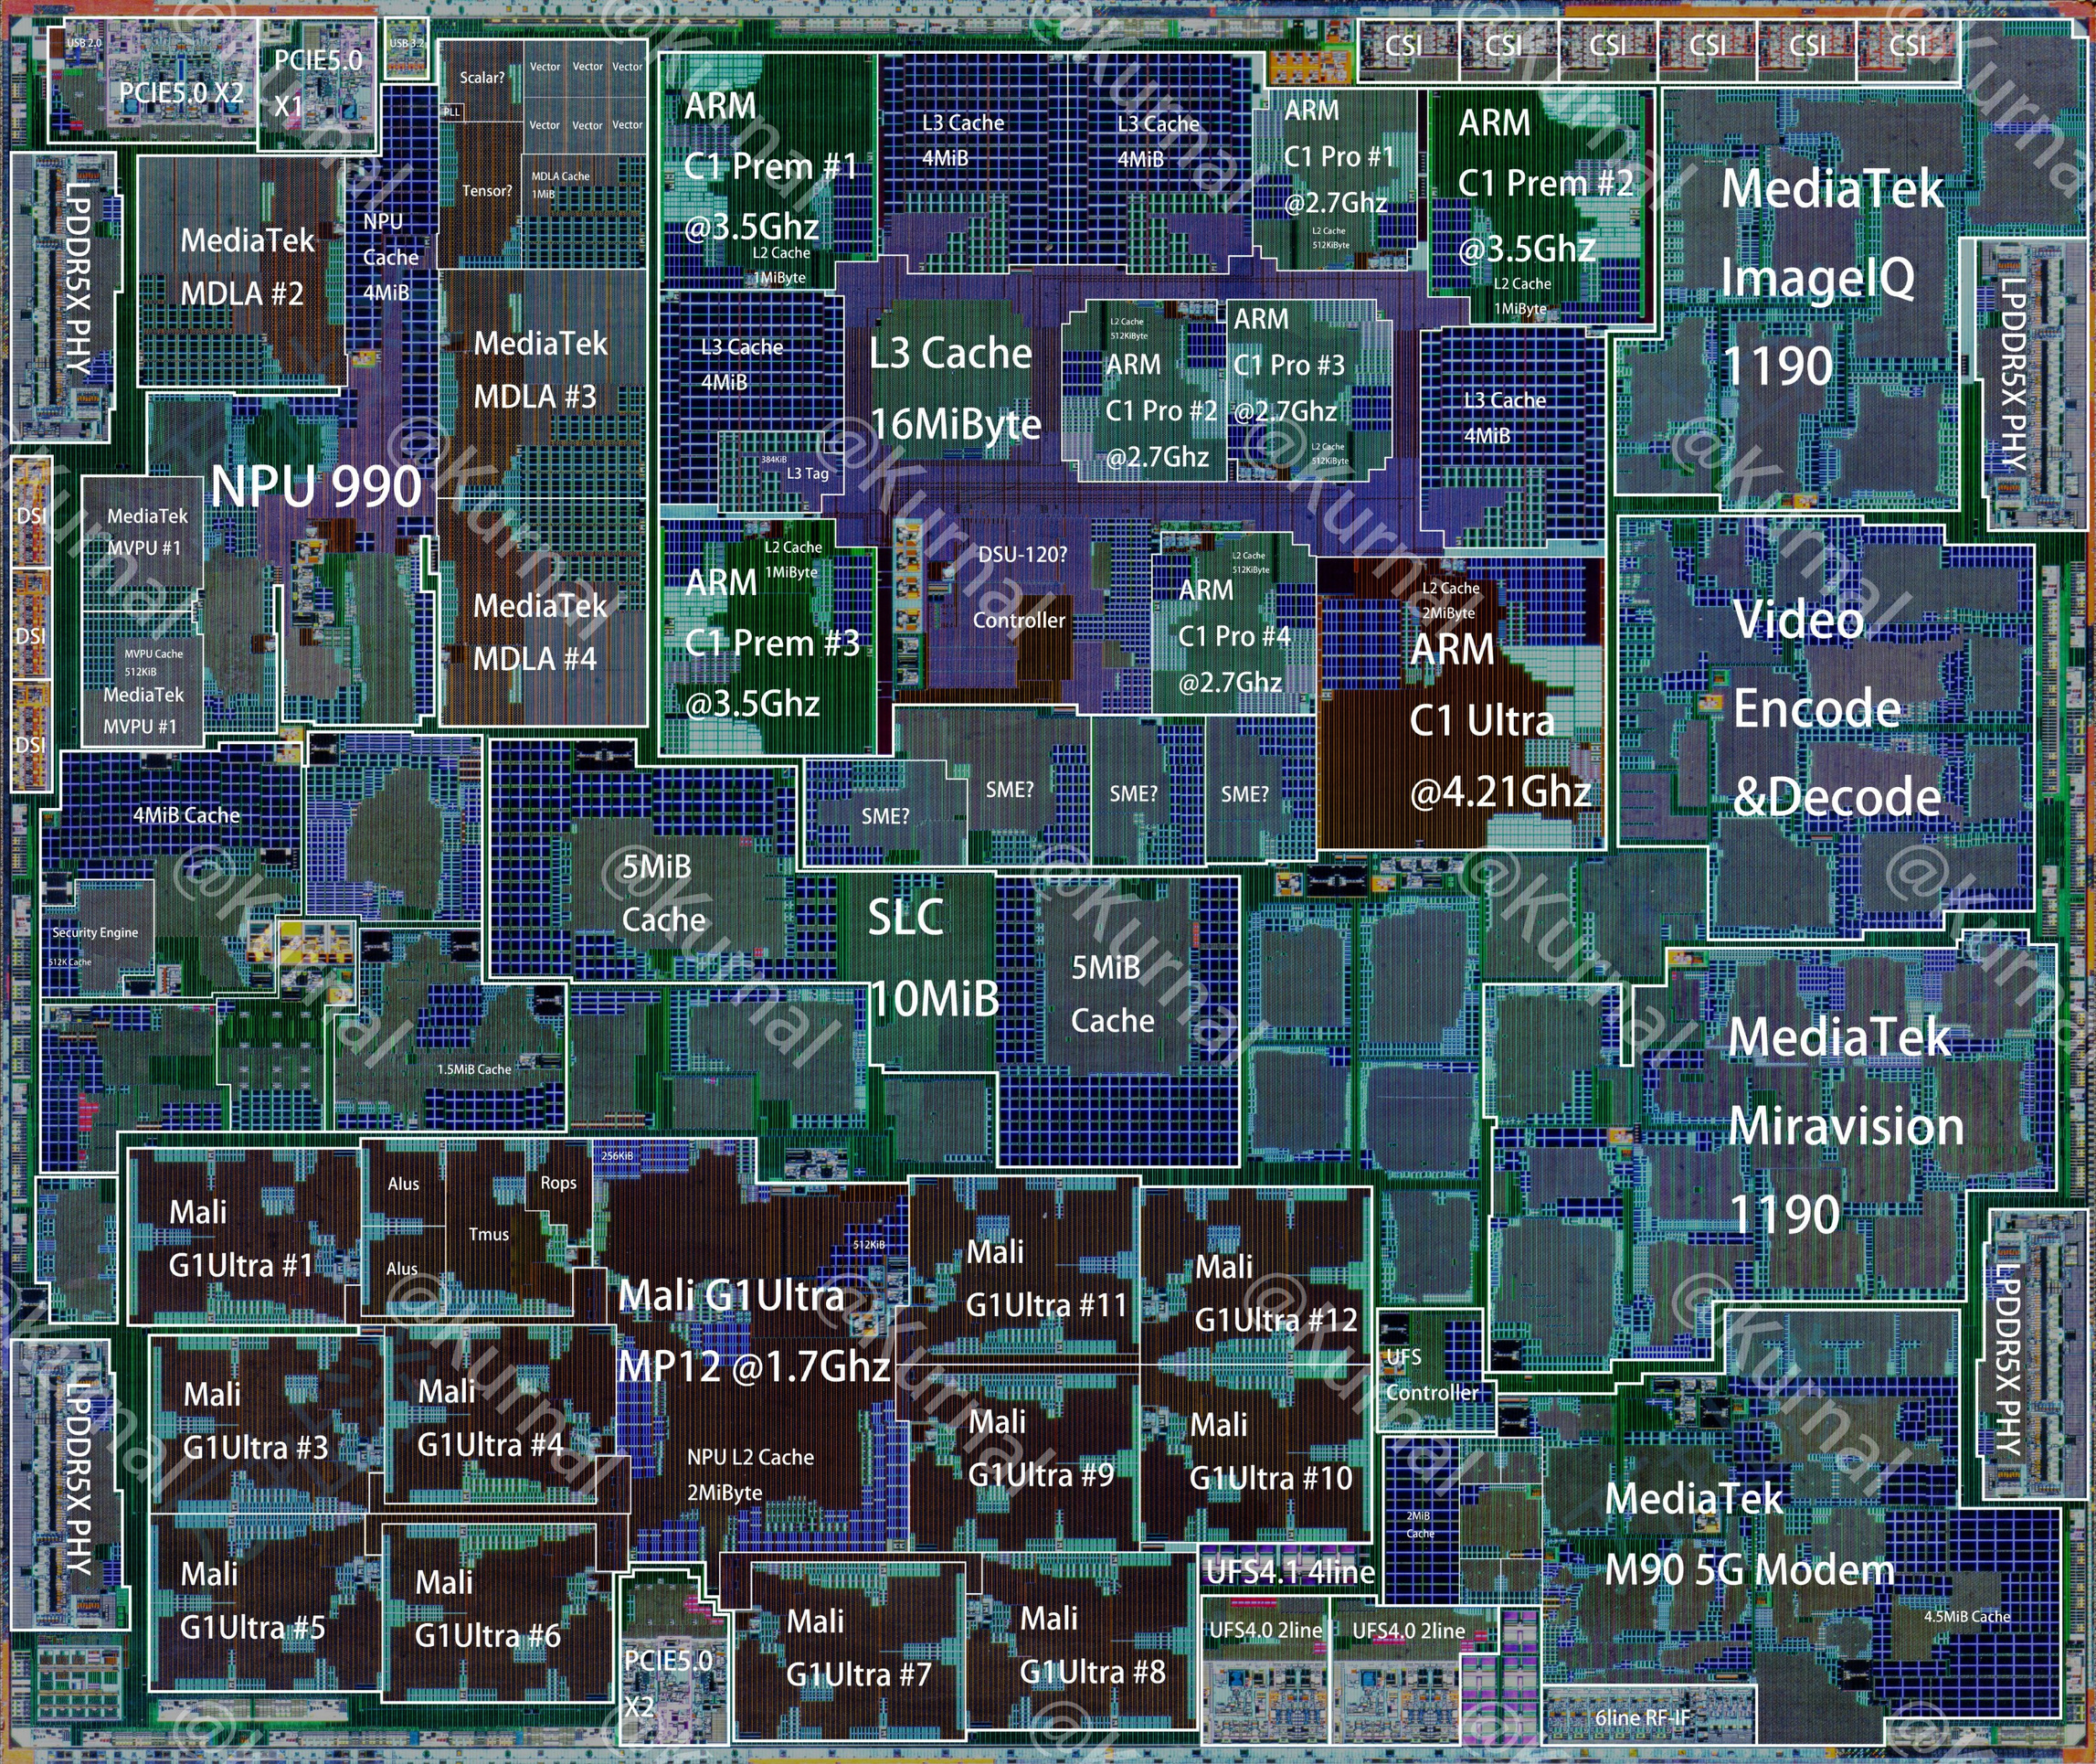
WEC Systems
Intro
Whats a GPU?
There was a time when GPU was nothing more than a Graphics Processor... Now? Its a lot more!
A Modern GPU is a type of Processor thats very good at performing Arithmetic and Logical Operations on multiple “data points” simultaneously, aka SIMD.
A GPU is SIMD on Steroids!

Slide 3

WEC Systems
About iGPU
When did my phone get a GPU??
Integrated
GPUs
These offer decent performance whilst drawing less power. Its usually pre-packaged with the CPU/SOC
Can be found on Laptops and Phones. Thhese are typically called iGPUs
Ever heard of Intel Xe3 graphics?
Imagination PowerVR?
Qualcomm Adreno or ARM Immortalis?
Even the Apple GPU is another example.

Slide 4
WEC Systems
About iGPU
iGPU Memory
Unlike Discrete Graphics Cards such as the Nvidia RTX3060 and others, iGPUs don’t have dedicated RAM.
It shares RAM with the CPU itself, which removes the need for copying data between the two.
So whats different in iGPUs?
An iGPU just works marvels on handhelds

Slide 5
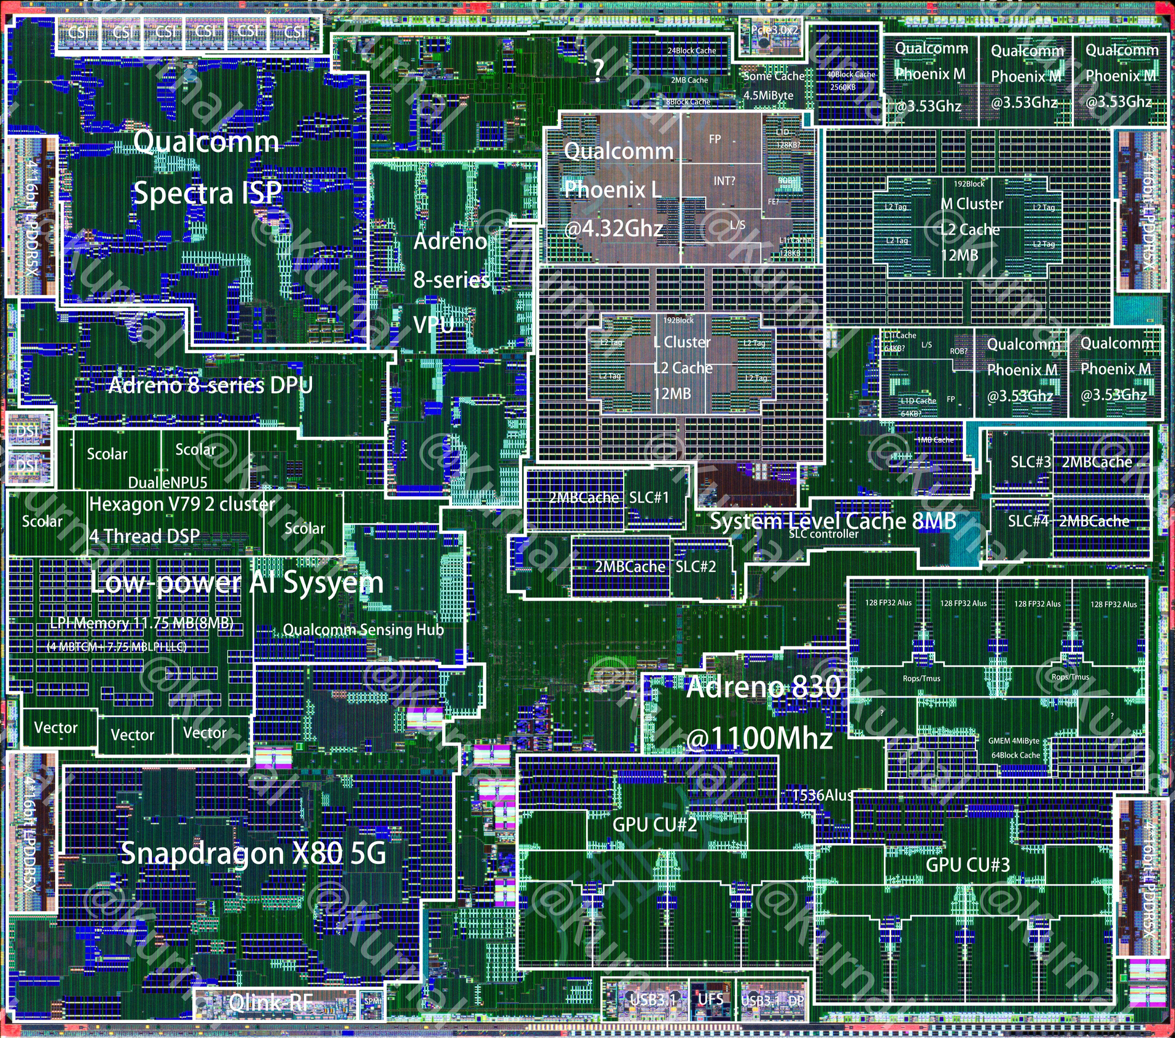
WEC Systems
About OpenGLES
Taming the Beast
with OpenGLES
OpenGLES is a graphics API used to work with iGPUs on Mobile devices.
Its an open standard maintained by the Khronos Group.

Slide 6
WEC Systems
About OpenGLES
As OpenGLES is an open standard, it works on almost all devices, which also includes iPhones.
OpenGLES in a nutshell
Using this API, the CPU “tells” the GPU “what is to be done”. The CPU writes the data to be “crunched”, into memory containers called buffers. Buffers are just plain ol’ arrays!
The “programs” executed on a GPU thread are called shaders.
This is Heterogenous Computing!

Slide 7
WEC Systems
Terminology
Some Terms you need!
GPU
Terminology - I
Threads: This is the smallest unit of execution that runs the shader program.
Warps: A warp is a collection of threads.
Warp width: This is the number of threads per warp. Its usually 4 to 16 on mobile.
Cores: Consists of multiple Warps and can execute them simultaneously
Work Group: A unit of “work” to be done

Slide 8
WEC Systems
Terminology
Some Terms you need!
GPU
Terminology - II
Local Workgroup: Represents a logical collection of threads executing simultaneously per GPU Core. The threads within this group can share resources and synchronise.
Local Workgroup size: Number of threads that belong to the LWG.
Global Workgroup: Represents the total number of LWGs to be executed.

Slide 9


WEC Systems
Lets see some code!
GitHub Repo
Executables

Slide 10
WEC Systems
The Future
AI, Automation, and Beyond
In the data driven world, where AI and ML are playing a big role, the need for such vector processors has hit us hard.
The advantage of Heterogenous Computing is not superficial anymore. It has real benefits. It seeks to reduce power draw and maximize performance.
Programming the Future
The Future of GPU Programming

Slide 11
WEC Systems
Thank You

